Slide 1
Financial Mathematics
Numbers and sets of numbers

Slide 5
(
)

Slide 7
)

Slide 9
(

Slide 11
[
]

Slide 13
]

Slide 15
[

Slide 17
(
]

Slide 19
[
)

Slide 29
(
]

Slide 30
(
]
(
]

Slide 31
(
]
[
]

Slide 32
[
)
[
]

Slide 35
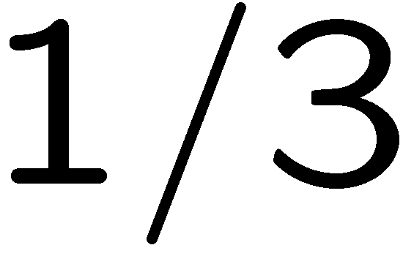
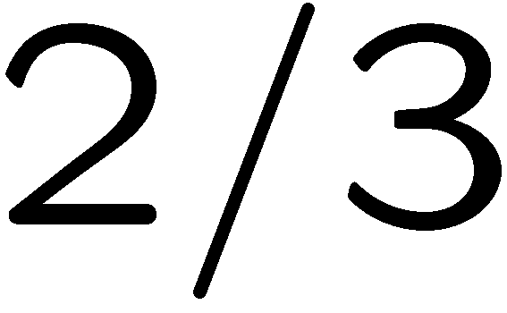

Slide 36
[
)

Slide 37
[

Slide 40
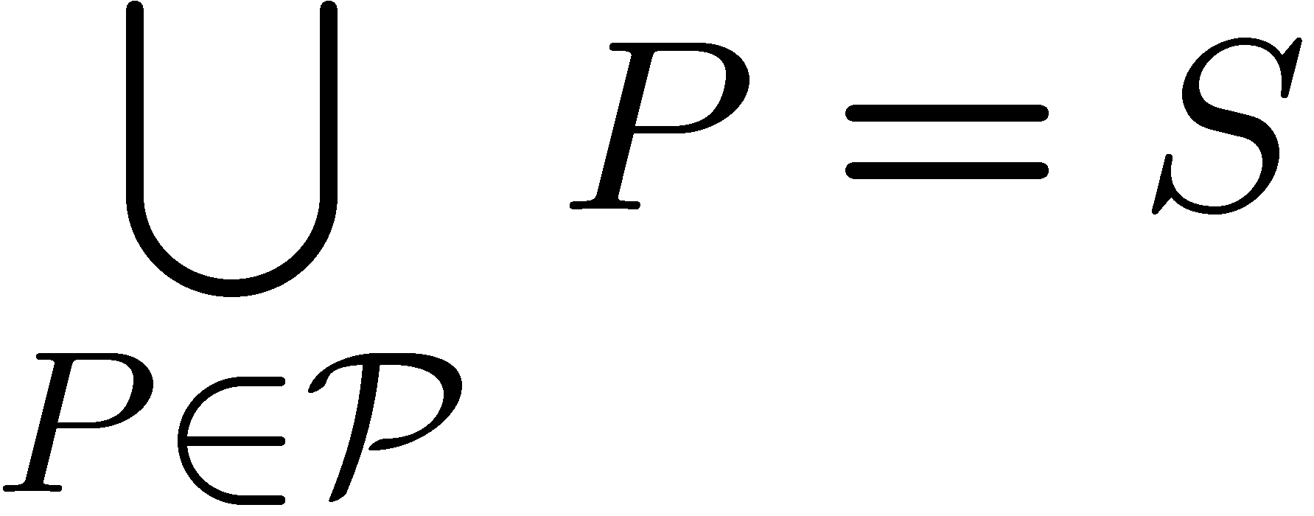

Slide 43
STOP

