Slide 1
Calculus
F 14 September 2012

Slide 5
1+1=
1
2
3
4
1 | 2 | 3 | 4 | 5 | 6 | 7 | 8 | 9 | 10 | 11 | 12 | 13 | 14 | 15 | 16 | 17 | 18 | 19 | 20
21 | 22 | 23 | 24 | 25 | 26 | 27 | 28 | 29 | 30
0 of 5

Slide 6
1+1=
1
2
3
4
1 | 2 | 3 | 4 | 5 | 6 | 7 | 8 | 9 | 10 | 11 | 12 | 13 | 14 | 15 | 16 | 17 | 18 | 19 | 20
21 | 22 | 23 | 24 | 25 | 26 | 27 | 28 | 29 | 30
0 of 5

Slide 7
1+1=
1
2
3
4
1 | 2 | 3 | 4 | 5 | 6 | 7 | 8 | 9 | 10 | 11 | 12 | 13 | 14 | 15 | 16 | 17 | 18 | 19 | 20
21 | 22 | 23 | 24 | 25 | 26 | 27 | 28 | 29 | 30
0 of 5

Slide 8
1+1=
1
2
3
4
1 | 2 | 3 | 4 | 5 | 6 | 7 | 8 | 9 | 10 | 11 | 12 | 13 | 14 | 15 | 16 | 17 | 18 | 19 | 20
21 | 22 | 23 | 24 | 25 | 26 | 27 | 28 | 29 | 30
0 of 5

Slide 9
1+1=
1
2
3
4
1 | 2 | 3 | 4 | 5 | 6 | 7 | 8 | 9 | 10 | 11 | 12 | 13 | 14 | 15 | 16 | 17 | 18 | 19 | 20
21 | 22 | 23 | 24 | 25 | 26 | 27 | 28 | 29 | 30
0 of 5

Slide 10
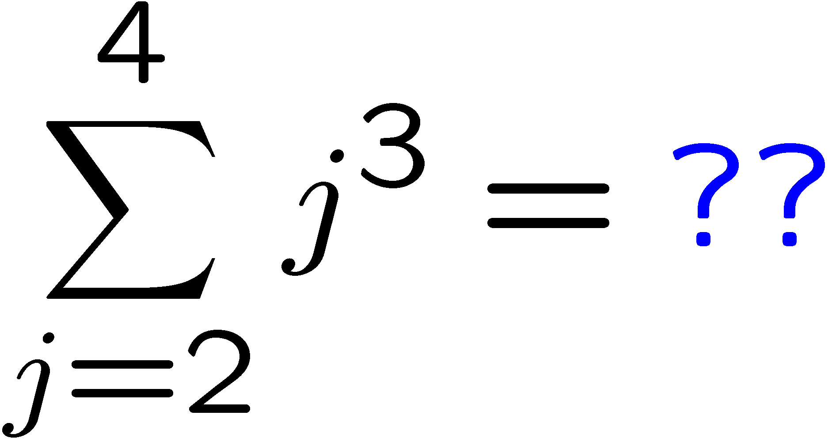
1+1=
1
2
3
4
1 | 2 | 3 | 4 | 5 | 6 | 7 | 8 | 9 | 10 | 11 | 12 | 13 | 14 | 15 | 16 | 17 | 18 | 19 | 20
21 | 22 | 23 | 24 | 25 | 26 | 27 | 28 | 29 | 30
0 of 5

Slide 11
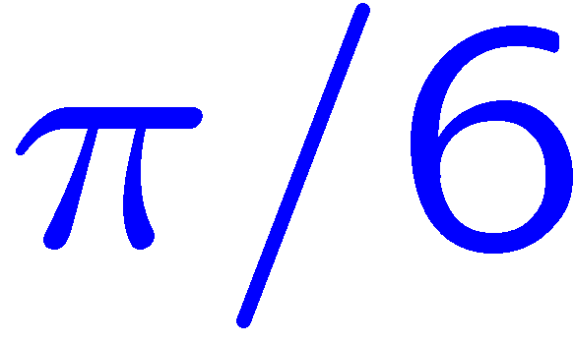
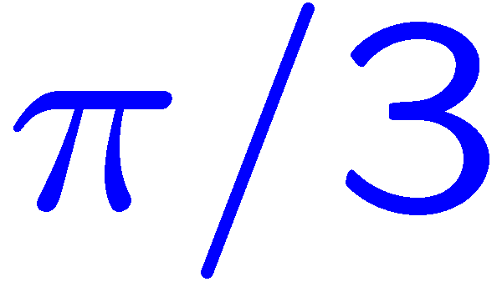
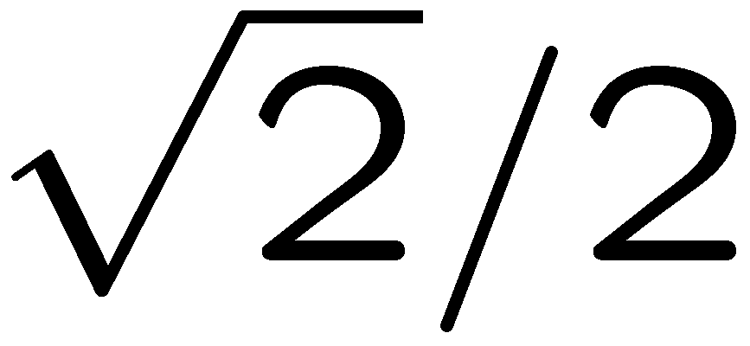
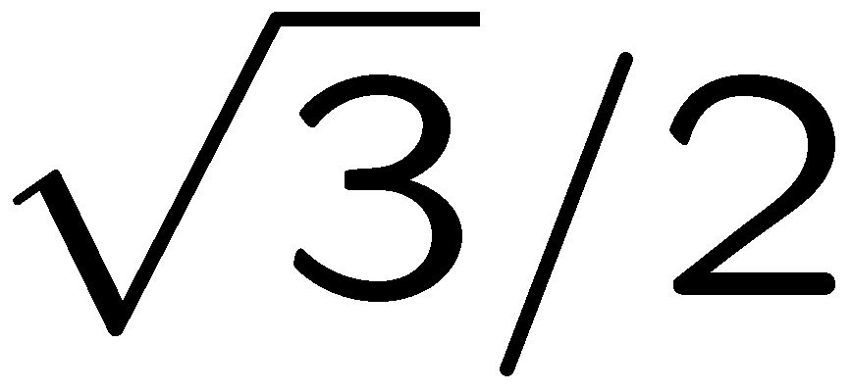
1+1=
1
2
3
4
1 | 2 | 3 | 4 | 5 | 6 | 7 | 8 | 9 | 10 | 11 | 12 | 13 | 14 | 15 | 16 | 17 | 18 | 19 | 20
21 | 22 | 23 | 24 | 25 | 26 | 27 | 28 | 29 | 30
0 of 5

Slide 12
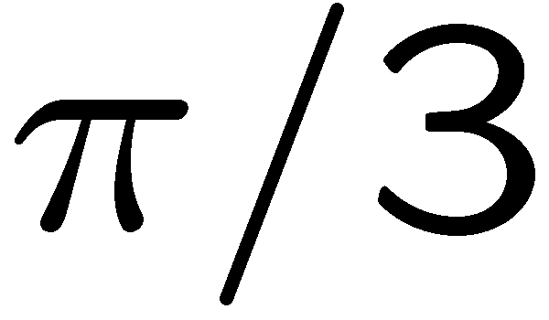
1+1=
1
2
3
4
1 | 2 | 3 | 4 | 5 | 6 | 7 | 8 | 9 | 10 | 11 | 12 | 13 | 14 | 15 | 16 | 17 | 18 | 19 | 20
21 | 22 | 23 | 24 | 25 | 26 | 27 | 28 | 29 | 30
0 of 5

Slide 13
1+1=
1
2
3
4
1 | 2 | 3 | 4 | 5 | 6 | 7 | 8 | 9 | 10 | 11 | 12 | 13 | 14 | 15 | 16 | 17 | 18 | 19 | 20
21 | 22 | 23 | 24 | 25 | 26 | 27 | 28 | 29 | 30
0 of 5

Slide 14
1+1=
1
2
3
4
1 | 2 | 3 | 4 | 5 | 6 | 7 | 8 | 9 | 10 | 11 | 12 | 13 | 14 | 15 | 16 | 17 | 18 | 19 | 20
21 | 22 | 23 | 24 | 25 | 26 | 27 | 28 | 29 | 30
0 of 5

Slide 15
1+1=
1
2
1 | 2 | 3 | 4 | 5 | 6 | 7 | 8 | 9 | 10 | 11 | 12 | 13 | 14 | 15 | 16 | 17 | 18 | 19 | 20
21 | 22 | 23 | 24 | 25 | 26 | 27 | 28 | 29 | 30 | 31 | 32 | 33 | 34 | 35 | 36 | 37 | 38 | 39 | 40
0 of 5

Slide 16
1+1=
1
2
3
4
1 | 2 | 3 | 4 | 5 | 6 | 7 | 8 | 9 | 10 | 11 | 12 | 13 | 14 | 15 | 16 | 17 | 18 | 19 | 20
21 | 22 | 23 | 24 | 25 | 26 | 27 | 28 | 29 | 30 | 31 | 32 | 33 | 34 | 35 | 36 | 37 | 38 | 39 | 40
0 of 5

Slide 17
1+1=
1
2
3
4
1 | 2 | 3 | 4 | 5 | 6 | 7 | 8 | 9 | 10 | 11 | 12 | 13 | 14 | 15 | 16 | 17 | 18 | 19 | 20
21 | 22 | 23 | 24 | 25 | 26 | 27 | 28 | 29 | 30 | 31 | 32 | 33 | 34 | 35 | 36 | 37 | 38 | 39 | 40
0 of 5

Slide 18
1+1=
1
2
3
4
1 | 2 | 3 | 4 | 5 | 6 | 7 | 8 | 9 | 10 | 11 | 12 | 13 | 14 | 15 | 16 | 17 | 18 | 19 | 20
21 | 22 | 23 | 24 | 25 | 26 | 27 | 28 | 29 | 30 | 31 | 32 | 33 | 34 | 35 | 36 | 37 | 38 | 39 | 40
0 of 5

Slide 19
1+1=
1
2
3
4
1 | 2 | 3 | 4 | 5 | 6 | 7 | 8 | 9 | 10 | 11 | 12 | 13 | 14 | 15 | 16 | 17 | 18 | 19 | 20
21 | 22 | 23 | 24 | 25 | 26 | 27 | 28 | 29 | 30 | 31 | 32 | 33 | 34 | 35 | 36 | 37 | 38 | 39 | 40
0 of 5

Slide 20
1+1=
1
2
3
4
1 | 2 | 3 | 4 | 5 | 6 | 7 | 8 | 9 | 10 | 11 | 12 | 13 | 14 | 15 | 16 | 17 | 18 | 19 | 20
21 | 22 | 23 | 24 | 25 | 26 | 27 | 28 | 29 | 30 | 31 | 32 | 33 | 34 | 35 | 36 | 37 | 38 | 39 | 40
0 of 5

Slide 21
1+1=
1
2
3
4
1 | 2 | 3 | 4 | 5 | 6 | 7 | 8 | 9 | 10 | 11 | 12 | 13 | 14 | 15 | 16 | 17 | 18 | 19 | 20
21 | 22 | 23 | 24 | 25 | 26 | 27 | 28 | 29 | 30 | 31 | 32 | 33 | 34 | 35 | 36 | 37 | 38 | 39 | 40
0 of 5

Slide 22
1+1=
1
2
3
4
1 | 2 | 3 | 4 | 5 | 6 | 7 | 8 | 9 | 10 | 11 | 12 | 13 | 14 | 15 | 16 | 17 | 18 | 19 | 20
21 | 22 | 23 | 24 | 25 | 26 | 27 | 28 | 29 | 30 | 31 | 32 | 33 | 34 | 35 | 36 | 37 | 38 | 39 | 40
0 of 5

Slide 23
1+1=
1
2
3
4
1 | 2 | 3 | 4 | 5 | 6 | 7 | 8 | 9 | 10 | 11 | 12 | 13 | 14 | 15 | 16 | 17 | 18 | 19 | 20
21 | 22 | 23 | 24 | 25 | 26 | 27 | 28 | 29 | 30 | 31 | 32 | 33 | 34 | 35 | 36 | 37 | 38 | 39 | 40
0 of 5

Slide 24
1+1=
1
2
3
4
1 | 2 | 3 | 4 | 5 | 6 | 7 | 8 | 9 | 10 | 11 | 12 | 13 | 14 | 15 | 16 | 17 | 18 | 19 | 20
21 | 22 | 23 | 24 | 25 | 26 | 27 | 28 | 29 | 30 | 31 | 32 | 33 | 34 | 35 | 36 | 37 | 38 | 39 | 40
0 of 5

Slide 25
1+1=
1
2
3
4
1 | 2 | 3 | 4 | 5 | 6 | 7 | 8 | 9 | 10 | 11 | 12 | 13 | 14 | 15 | 16 | 17 | 18 | 19 | 20
21 | 22 | 23 | 24 | 25 | 26 | 27 | 28 | 29 | 30 | 31 | 32 | 33 | 34 | 35 | 36 | 37 | 38 | 39 | 40
0 of 5

Slide 26
1+1=
1
2
3
4
1 | 2 | 3 | 4 | 5 | 6 | 7 | 8 | 9 | 10 | 11 | 12 | 13 | 14 | 15 | 16 | 17 | 18 | 19 | 20
21 | 22 | 23 | 24 | 25 | 26 | 27 | 28 | 29 | 30 | 31 | 32 | 33 | 34 | 35 | 36 | 37 | 38 | 39 | 40
0 of 5

Slide 27
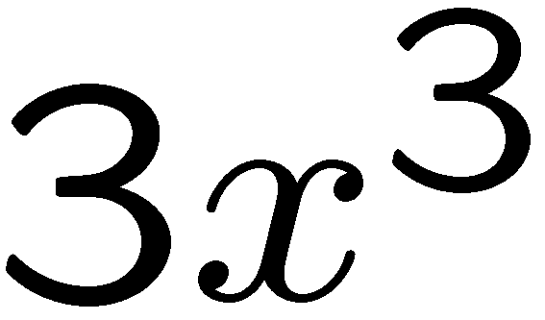
1+1=
1
2
3
4
1 | 2 | 3 | 4 | 5 | 6 | 7 | 8 | 9 | 10 | 11 | 12 | 13 | 14 | 15 | 16 | 17 | 18 | 19 | 20
21 | 22 | 23 | 24 | 25 | 26 | 27 | 28 | 29 | 30 | 31 | 32 | 33 | 34 | 35 | 36 | 37 | 38 | 39 | 40
0 of 5

Slide 28
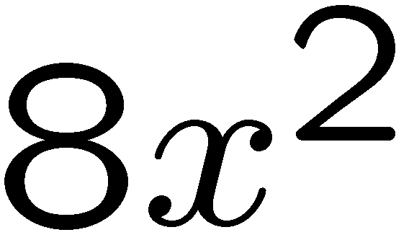
1+1=
1
2
3
4
1 | 2 | 3 | 4 | 5 | 6 | 7 | 8 | 9 | 10 | 11 | 12 | 13 | 14 | 15 | 16 | 17 | 18 | 19 | 20
21 | 22 | 23 | 24 | 25 | 26 | 27 | 28 | 29 | 30 | 31 | 32 | 33 | 34 | 35 | 36 | 37 | 38 | 39 | 40
0 of 5

Slide 29
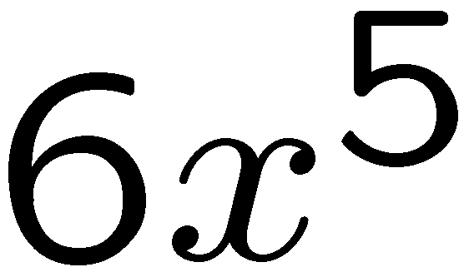
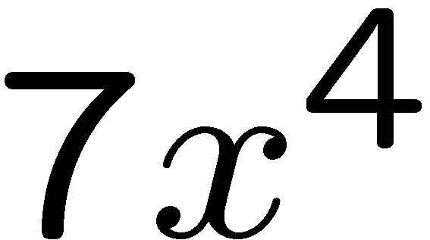
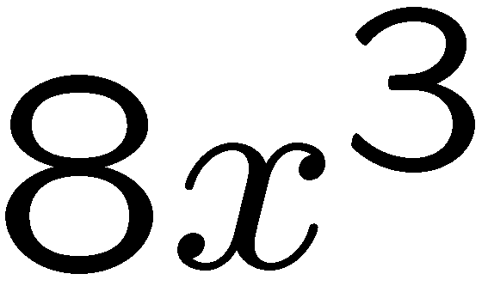
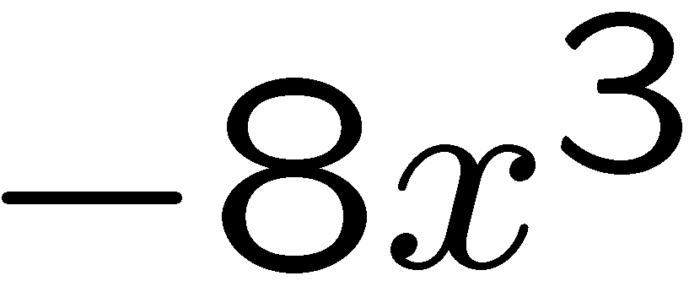
1+1=
1
2
3
4
1 | 2 | 3 | 4 | 5 | 6 | 7 | 8 | 9 | 10 | 11 | 12 | 13 | 14 | 15 | 16 | 17 | 18 | 19 | 20
21 | 22 | 23 | 24 | 25 | 26 | 27 | 28 | 29 | 30 | 31 | 32 | 33 | 34 | 35 | 36 | 37 | 38 | 39 | 40
0 of 5

Slide 30
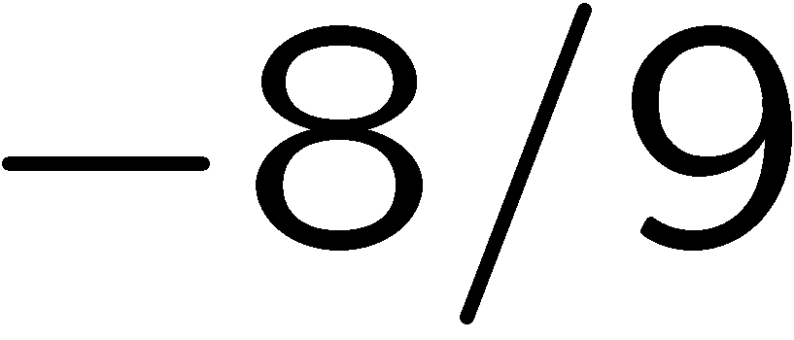
1+1=
1
2
3
4
1 | 2 | 3 | 4 | 5 | 6 | 7 | 8 | 9 | 10 | 11 | 12 | 13 | 14 | 15 | 16 | 17 | 18 | 19 | 20
21 | 22 | 23 | 24 | 25 | 26 | 27 | 28 | 29 | 30 | 31 | 32 | 33 | 34 | 35 | 36 | 37 | 38 | 39 | 40
0 of 5

Slide 31
1+1=
1
2
3
4
1 | 2 | 3 | 4 | 5 | 6 | 7 | 8 | 9 | 10 | 11 | 12 | 13 | 14 | 15 | 16 | 17 | 18 | 19 | 20
21 | 22 | 23 | 24 | 25 | 26 | 27 | 28 | 29 | 30 | 31 | 32 | 33 | 34 | 35 | 36 | 37 | 38 | 39 | 40
0 of 5

Slide 32
1+1=
1
2
3
4
1 | 2 | 3 | 4 | 5 | 6 | 7 | 8 | 9 | 10 | 11 | 12 | 13 | 14 | 15 | 16 | 17 | 18 | 19 | 20
21 | 22 | 23 | 24 | 25 | 26 | 27 | 28 | 29 | 30 | 31 | 32 | 33 | 34 | 35 | 36 | 37 | 38 | 39 | 40
0 of 5

Slide 33
1+1=
1
2
3
4
1 | 2 | 3 | 4 | 5 | 6 | 7 | 8 | 9 | 10 | 11 | 12 | 13 | 14 | 15 | 16 | 17 | 18 | 19 | 20
21 | 22 | 23 | 24 | 25 | 26 | 27 | 28 | 29 | 30 | 31 | 32 | 33 | 34 | 35 | 36 | 37 | 38 | 39 | 40
0 of 5

Slide 34
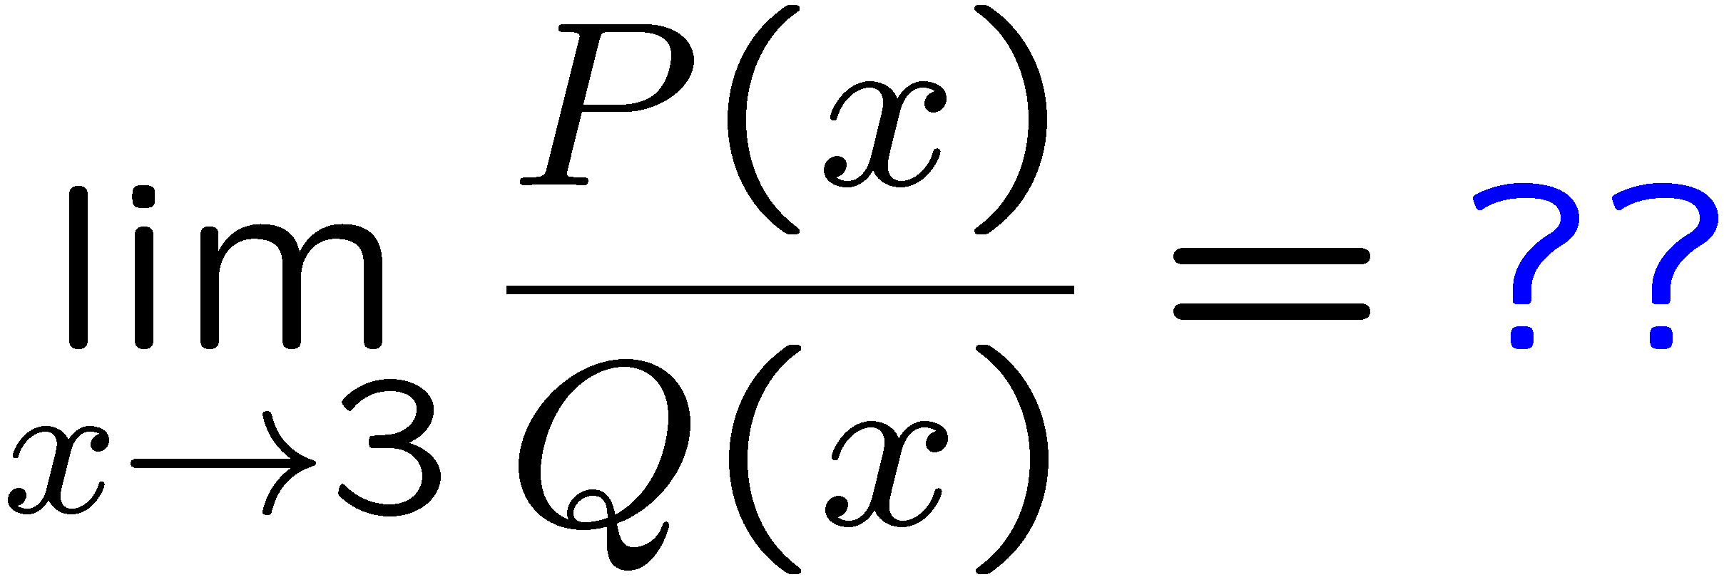
1+1=
1
2
3
4
1 | 2 | 3 | 4 | 5 | 6 | 7 | 8 | 9 | 10 | 11 | 12 | 13 | 14 | 15 | 16 | 17 | 18 | 19 | 20
21 | 22 | 23 | 24 | 25 | 26 | 27 | 28 | 29 | 30 | 31 | 32 | 33 | 34 | 35 | 36 | 37 | 38 | 39 | 40
0 of 5

Slide 35
1+1=
1
2
3
4
1 | 2 | 3 | 4 | 5 | 6 | 7 | 8 | 9 | 10 | 11 | 12 | 13 | 14 | 15 | 16 | 17 | 18 | 19 | 20
21 | 22 | 23 | 24 | 25 | 26 | 27 | 28 | 29 | 30 | 31 | 32 | 33 | 34 | 35 | 36 | 37 | 38 | 39 | 40
0 of 5

Slide 36
1+1=
1
2
3
4
1 | 2 | 3 | 4 | 5 | 6 | 7 | 8 | 9 | 10 | 11 | 12 | 13 | 14 | 15 | 16 | 17 | 18 | 19 | 20
21 | 22 | 23 | 24 | 25 | 26 | 27 | 28 | 29 | 30 | 31 | 32 | 33 | 34 | 35 | 36 | 37 | 38 | 39 | 40
0 of 5

Slide 37
1+1=
1
2
3
4
1 | 2 | 3 | 4 | 5 | 6 | 7 | 8 | 9 | 10 | 11 | 12 | 13 | 14 | 15 | 16 | 17 | 18 | 19 | 20
21 | 22 | 23 | 24 | 25 | 26 | 27 | 28 | 29 | 30 | 31 | 32 | 33 | 34 | 35 | 36 | 37 | 38 | 39 | 40
0 of 5

Slide 38
1+1=
1
2
3
4
1 | 2 | 3 | 4 | 5 | 6 | 7 | 8 | 9 | 10 | 11 | 12 | 13 | 14 | 15 | 16 | 17 | 18 | 19 | 20
21 | 22 | 23 | 24 | 25 | 26 | 27 | 28 | 29 | 30 | 31 | 32 | 33 | 34 | 35 | 36 | 37 | 38 | 39 | 40
0 of 5

Slide 39
1+1=
1
2
3
4
1 | 2 | 3 | 4 | 5 | 6 | 7 | 8 | 9 | 10 | 11 | 12 | 13 | 14 | 15 | 16 | 17 | 18 | 19 | 20
21 | 22 | 23 | 24 | 25 | 26 | 27 | 28 | 29 | 30 | 31 | 32 | 33 | 34 | 35 | 36 | 37 | 38 | 39 | 40
0 of 5

Slide 40
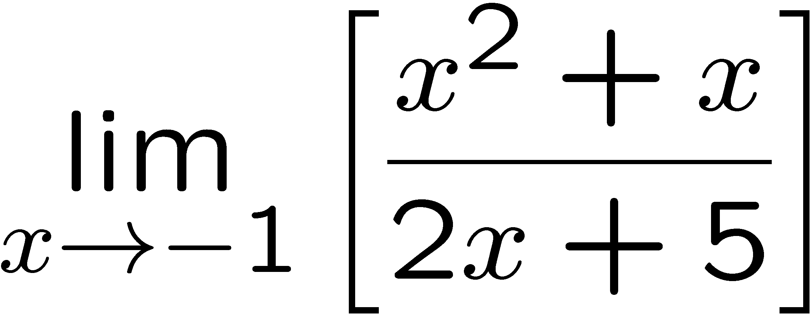
1+1=
1
2
3
4
1 | 2 | 3 | 4 | 5 | 6 | 7 | 8 | 9 | 10 | 11 | 12 | 13 | 14 | 15 | 16 | 17 | 18 | 19 | 20
21 | 22 | 23 | 24 | 25 | 26 | 27 | 28 | 29 | 30 | 31 | 32 | 33 | 34 | 35 | 36 | 37 | 38 | 39 | 40
0 of 5

