Slide 1
Calculus
W 24 October 2012

Slide 5
1+1=
1
2
1 | 2 | 3 | 4 | 5 | 6 | 7 | 8 | 9 | 10 | 11 | 12 | 13 | 14 | 15 | 16 | 17 | 18 | 19 | 20
21 | 22 | 23 | 24 | 25 | 26 | 27 | 28 | 29 | 30 | 31 | 32 | 33 | 34 | 35 | 36 | 37 | 38 | 39 | 40
0 of 5

Slide 6
1+1=
1
2
1 | 2 | 3 | 4 | 5 | 6 | 7 | 8 | 9 | 10 | 11 | 12 | 13 | 14 | 15 | 16 | 17 | 18 | 19 | 20
21 | 22 | 23 | 24 | 25 | 26 | 27 | 28 | 29 | 30 | 31 | 32 | 33 | 34 | 35 | 36 | 37 | 38 | 39 | 40
0 of 5

Slide 7
1+1=
1
2
1 | 2 | 3 | 4 | 5 | 6 | 7 | 8 | 9 | 10 | 11 | 12 | 13 | 14 | 15 | 16 | 17 | 18 | 19 | 20
21 | 22 | 23 | 24 | 25 | 26 | 27 | 28 | 29 | 30 | 31 | 32 | 33 | 34 | 35 | 36 | 37 | 38 | 39 | 40
0 of 5

Slide 8
1+1=
1
2
1 | 2 | 3 | 4 | 5 | 6 | 7 | 8 | 9 | 10 | 11 | 12 | 13 | 14 | 15 | 16 | 17 | 18 | 19 | 20
21 | 22 | 23 | 24 | 25 | 26 | 27 | 28 | 29 | 30 | 31 | 32 | 33 | 34 | 35 | 36 | 37 | 38 | 39 | 40
0 of 5

Slide 9
1+1=
1
2
1 | 2 | 3 | 4 | 5 | 6 | 7 | 8 | 9 | 10 | 11 | 12 | 13 | 14 | 15 | 16 | 17 | 18 | 19 | 20
21 | 22 | 23 | 24 | 25 | 26 | 27 | 28 | 29 | 30 | 31 | 32 | 33 | 34 | 35 | 36 | 37 | 38 | 39 | 40
0 of 5

Slide 10
1+1=
1
2
3
4
1 | 2 | 3 | 4 | 5 | 6 | 7 | 8 | 9 | 10 | 11 | 12 | 13 | 14 | 15 | 16 | 17 | 18 | 19 | 20
21 | 22 | 23 | 24 | 25 | 26 | 27 | 28 | 29 | 30 | 31 | 32 | 33 | 34 | 35 | 36 | 37 | 38 | 39 | 40
0 of 5

Slide 11
1+1=
1
2
3
4
1 | 2 | 3 | 4 | 5 | 6 | 7 | 8 | 9 | 10 | 11 | 12 | 13 | 14 | 15 | 16 | 17 | 18 | 19 | 20
21 | 22 | 23 | 24 | 25 | 26 | 27 | 28 | 29 | 30 | 31 | 32 | 33 | 34 | 35 | 36 | 37 | 38 | 39 | 40
0 of 5

Slide 12
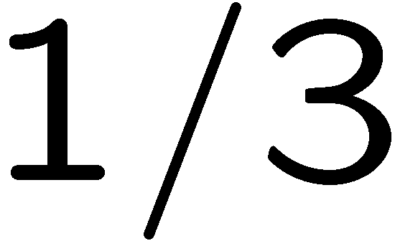
1+1=
1
2
3
4
1 | 2 | 3 | 4 | 5 | 6 | 7 | 8 | 9 | 10 | 11 | 12 | 13 | 14 | 15 | 16 | 17 | 18 | 19 | 20
21 | 22 | 23 | 24 | 25 | 26 | 27 | 28 | 29 | 30 | 31 | 32 | 33 | 34 | 35 | 36 | 37 | 38 | 39 | 40
0 of 5

