Slide 1
Calculus
F 27 September 2013

Slide 5
1+1=
1
2

Slide 6
1+1=
1
2
3
4

Slide 7
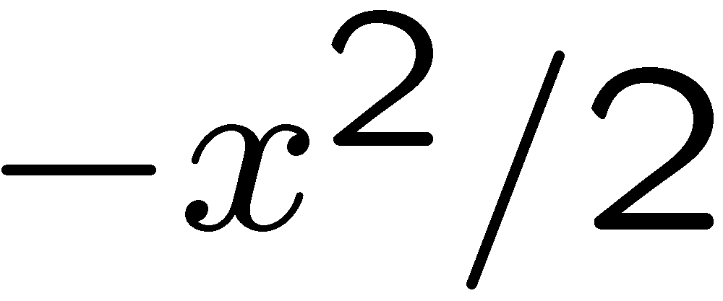
1+1=
1
2
3
4

Slide 8
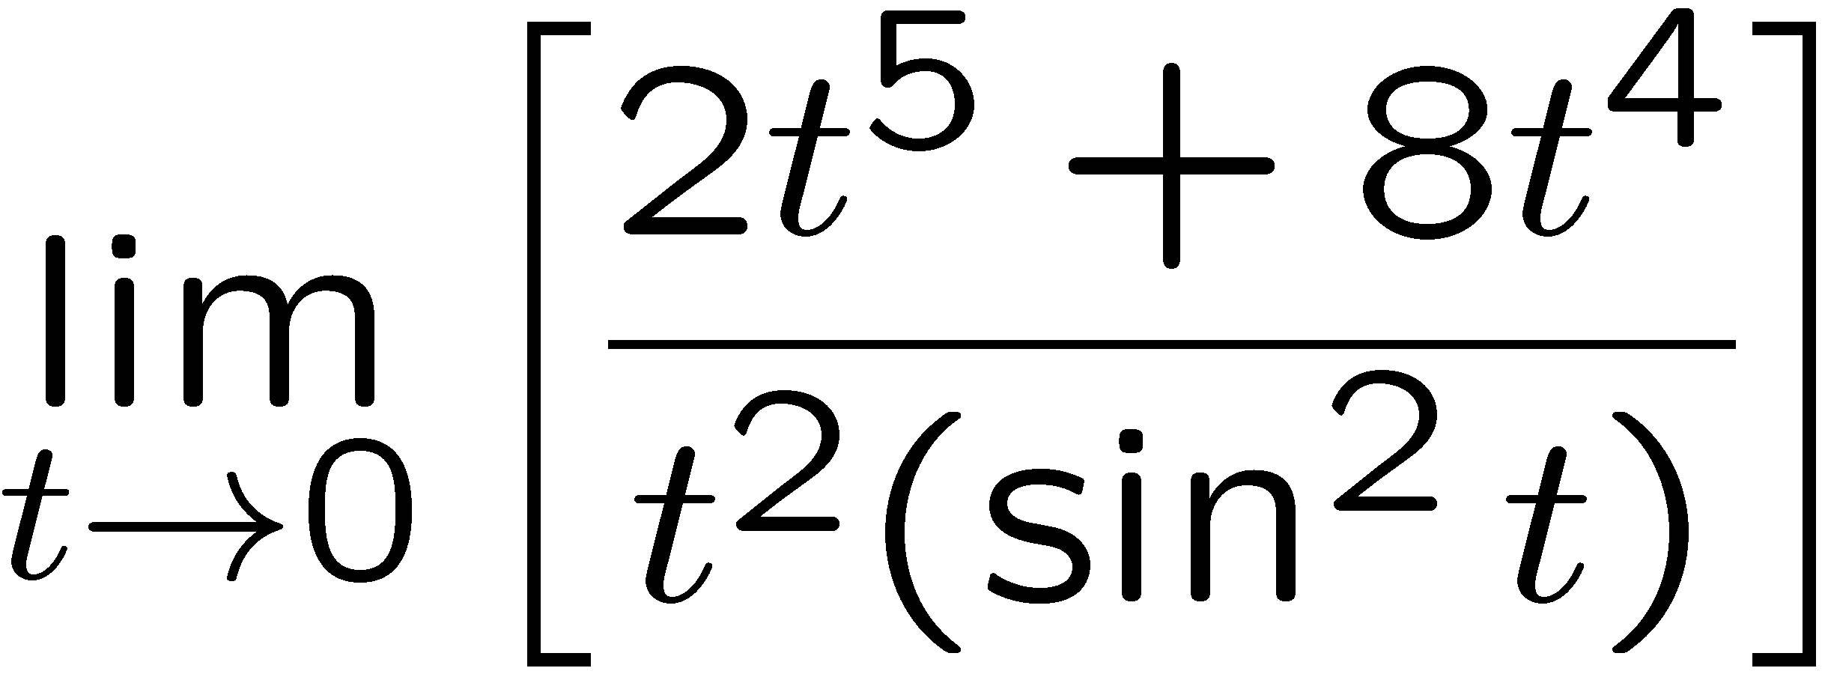
1+1=
1
2
3
4

