Slide 1
Calculus
F 18 October 2013

Slide 5
1+1=
1
2

Slide 6
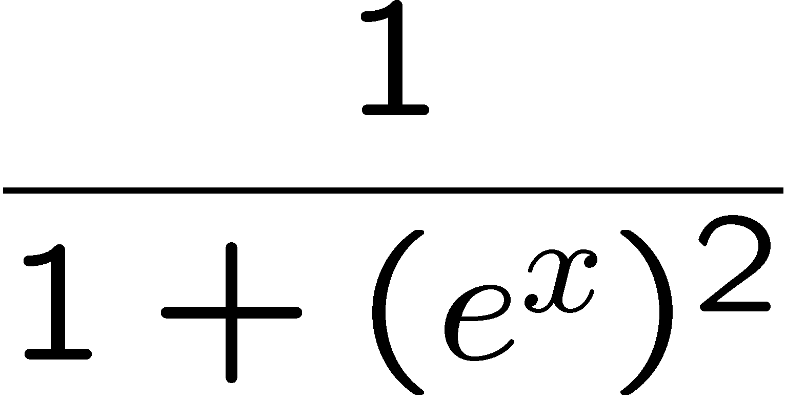
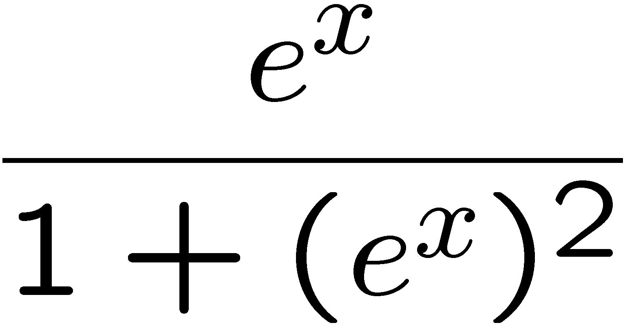
1+1=
1
2
3
4

Slide 7
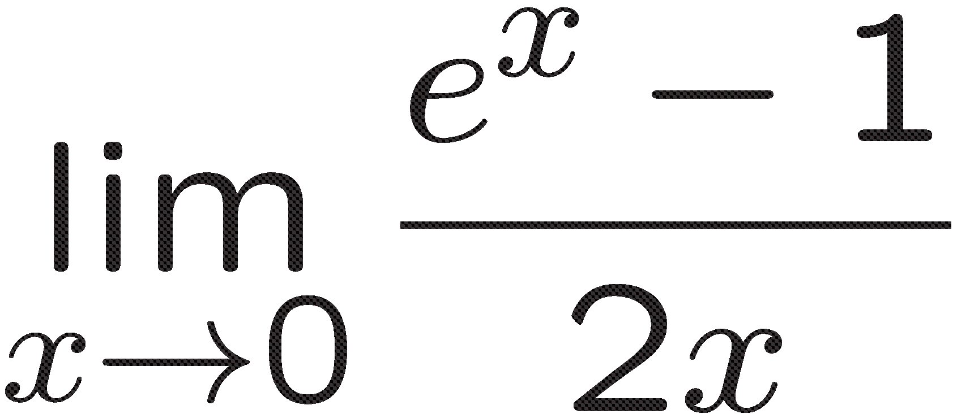
1+1=
3
4
1
2

Slide 8
1+1=
1
2
3
4

Slide 9
1+1=
1
2
3
4

