Slide 1
CALCULUS
The derivative of a function is a function

Slide 4
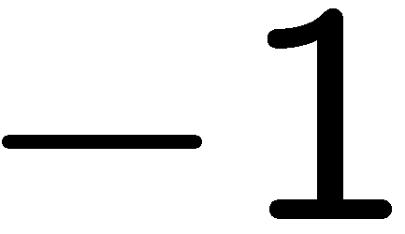

Slide 5
