Slide 1
Calculus
F 28 February 2014

Slide 4
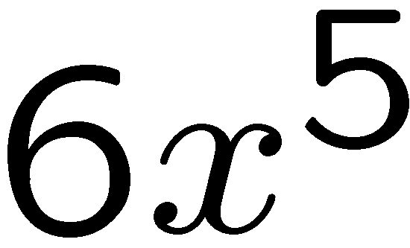
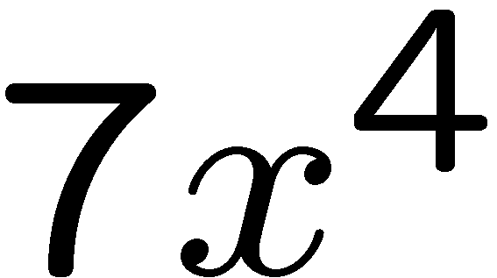
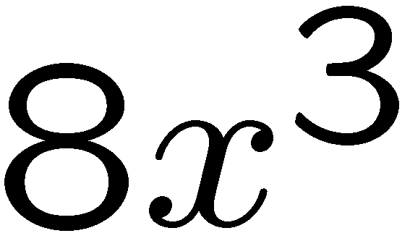
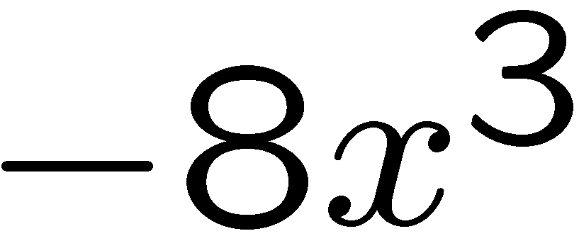
1+1=
1
2
3
4

Slide 5
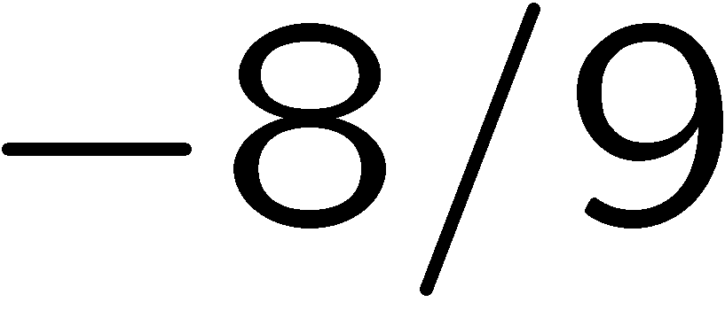
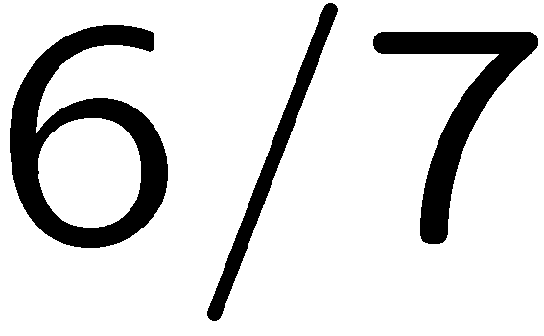
1+1=
1
2
3
4

Slide 6
1+1=
1
2
3
4

Slide 7
1+1=
1
2
3
4

Slide 8
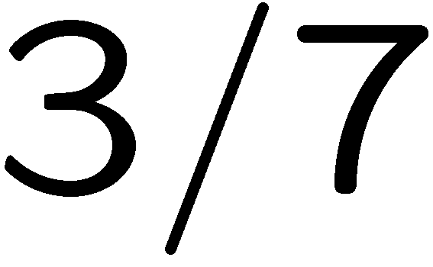
1+1=
1
2
3
4

Slide 9
1+1=
1
2
3
4

Slide 10
1+1=
1
2
3
4

