Slide 1
CALCULUS
Intervals of increase/decrease
and intervals of concavity

Slide 2
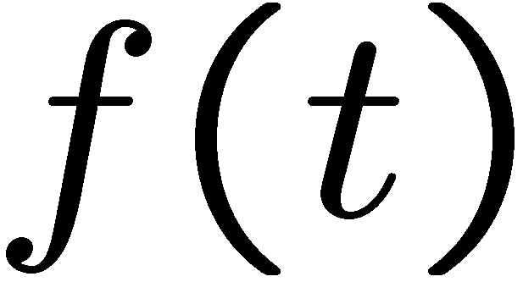
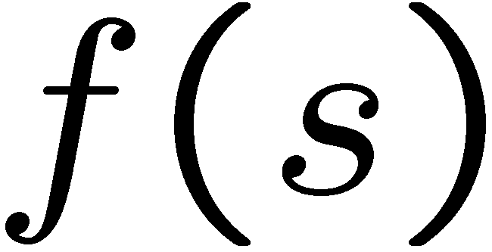

Slide 7
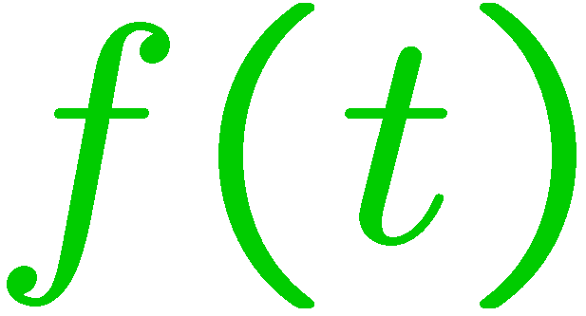

Slide 15
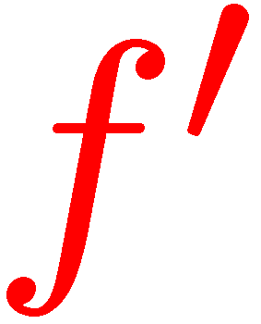

Slide 17
STOP

